Slide 1
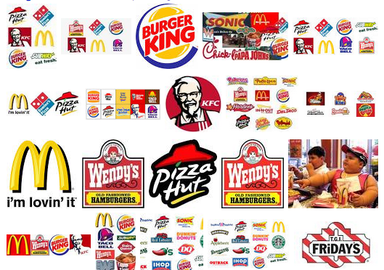
Fast Food Restaurants in U.S Exploratory Data Analysis
By Balaji Madgulwar

Slide 2
Fast Food Restaurants in U.S Exploratory Data Analysis
I have explored the fast food restaurants resides in U.S with the help of open source data available at github site.
I have applied the Numpy and Pandas library available in python for getting out the meaningful insights from the dataset.
I have used the Seaborn,Matplotlib and plotly visualization library available in python for plotting the beautiful graph for better representation and understanding of given dataset in visual form.
I have dropped the unuseful columns having Null values present in the given dataset for our further analysis.
I have completed the analysis of given dataset by asking the meaningful question and getting out the relationship of columns with each other and finding out the patterns present in the given dataset.
Finally I have captured the observation and summarized into the conclusion section.

Slide 3
Fast Food Restaurants in U.S Exploratory Data Analysis
The dataset consists of the information of various fast food restaurants present in U.S. giving insights about the distribution of restaurants along different states with 10000 observations and 9 columns.
Below table will give the explanation of each column present in the given dataset.
Column Name | Description
address | Address of the restaurants
city | city name in which restaurants resides
country | country name in which restaurants resides
keys | key consists of country ,province ,city and address and random number
latitude | latitude of the restaurants
longitude | longitude of the restaurants
name | name of the restaurants
postalcode | postalcode of the restaurants
province | state of the restaurants
websites | website of the restaurants

Slide 4
Fast Food Restaurants in U.S Exploratory Data Analysis
Below listed few question through which I have carried over my analysis on the given dataset.
Which state have a maximum no. of fast food restaurants in U.S?
Which city have a maximum no. of fast food restaurants in U.S?
Which fast food restaurants is most famous in U.S?
How the fast food restaurants distributed in top 3 states of U.S?
Which state have a minimum no. of fast food restaurants in U.S?
Which city have a minimum no. of fast food restaurants in U.S?
How the fast food restaurants in U.S is distributed by different region?
I have pointed out the observation after each question and plotting the appropriate plot for better understanding.

Slide 5
Fast Food Restaurants in U.S Exploratory Data Analysis
Firstly I have read the csv file of the given dataset with read_csv pandas function.
Applied the info and describe function for getting the descriptive and columns in which null values are present for further analysis.
I have used the pandas_profiling library for getting the info of the columns in the interactive way and used for taking decision for handling the null values in the particular column.
I have plotted the appropriate graphs for better visualization of the data according to the question that I have frame .
Lastly I have captured the observation after each question and pointed out in the conclusion section.

Slide 6
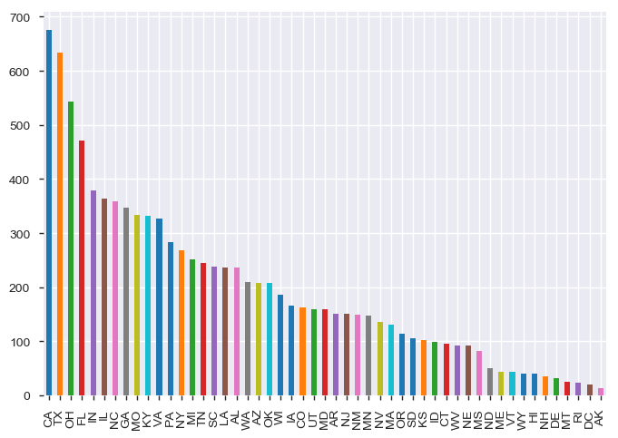
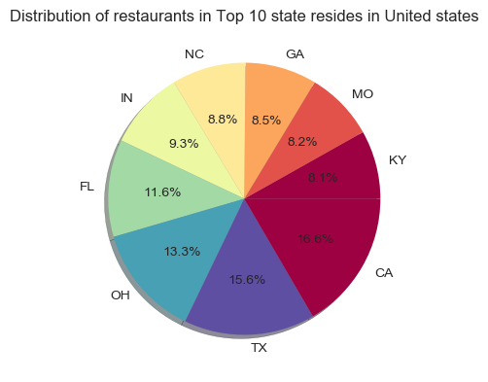
Which state have a maximum no. of fast food restaurants in U.S?
Bar Plot
Pie Plot
CA states have 676 fast food restaurants which is higher than other states which is 6.8% of total restaurants resides in United states.

Slide 7
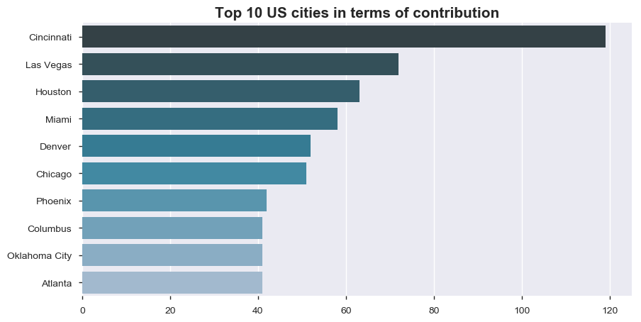
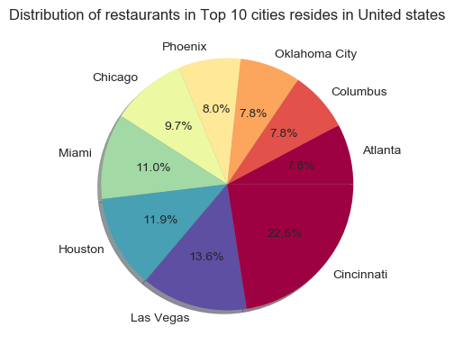
Which city have a maximum no. of fast food restaurants in U.S?
Bar Plot
Pie Plot
Cincinnati city have 119 fast food restaurants which is 22.5% with respect to other top cities resides in United States.

Slide 8
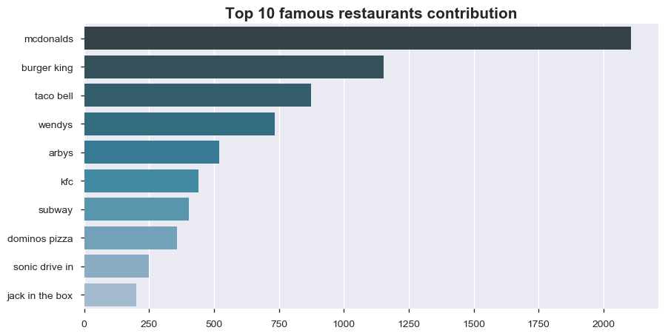
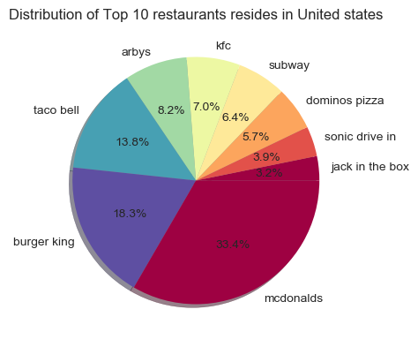
Which fast food restaurants is most famous in U.S?
Bar Plot
Pie plot
The mcdonalds have 2105 fast food shopes which is 33.4% of other top fast food restaurants resides in United states

Slide 9
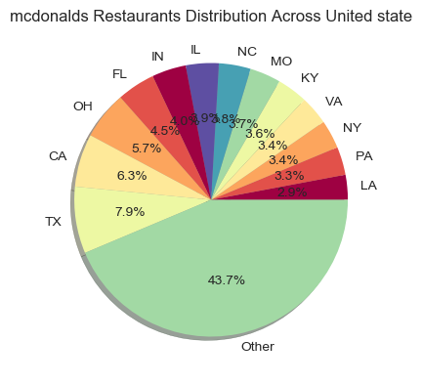
Distribution of mcdonalds restaurants in U.S
Pie Plot
The TX state have 166 mcdonalds restaurants which is 7.9% of all the states resides in U.S. which is maximum compared to other states lies in United States.

Slide 10
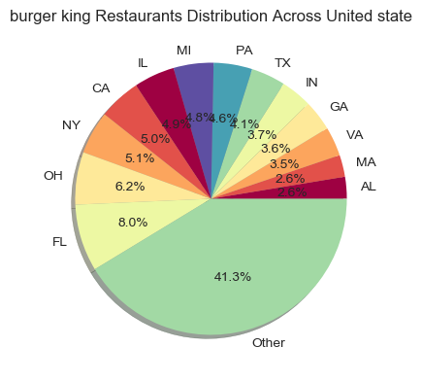
Distribution of burger king restaurants in U.S
Pie Plot
The FL state have 92 burger king restaurants which is 8.0% of all the states resides in U.S. which is maximum compared to other states lies in United States.

Slide 11
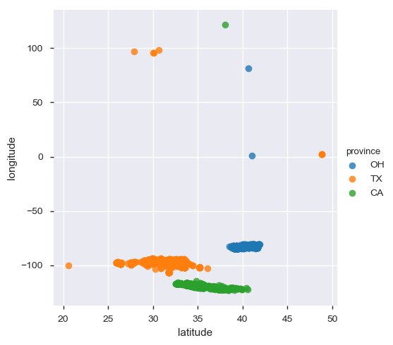
How the fast food restaurants distributed in top 3 states of U.S?
lmPlot
CA state restaurants resides in latitude range between 32.5453 to 40.569552
and longitude range between -122.81868899999999 to 121.337911.
TX state restaurants resides in latitude range between 20.578695611 to 48.8713 and longitude range between -106.57359 to 98.44620227.

Slide 12
How the fast food restaurants distributed in top 3 states of U.S?
OH state restaurants resides in latitude range between 20.578695611 to 48.8713 and longitude range between -84.8018 to 81.18815618.
Most of the restaurants in CA state lies in Los Angeles city.
Houston city have maximum no. of fast food restaurants resides in TX state.
Cincinnati city have maximum no. of restaurants resides in OH state.

Slide 13
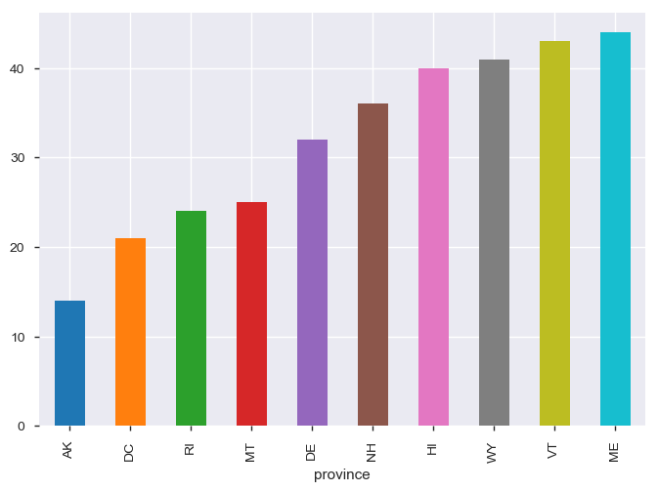
Which state have a minimum no. of fast food restaurants in U.S? (considered first 10 states)
Bar Plot
AK state have 14 fast food restaurants in U.S which is minimum

Slide 14
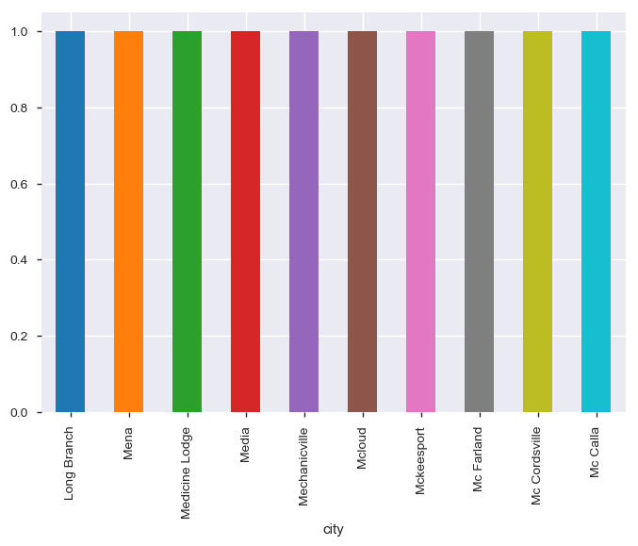
Which city have a minimum no. of fast food restaurants in U.S? (Considered first 10 city)
Bar Plot
Long Branch,Mena,Medicine,Lodge,Media,Mechaniville,Mcloud,
,Mckeesport,Mc Farland,Mc Cordsville,Mc Calla cities have only 1 fast food restaurants resides in U.S.

Slide 15
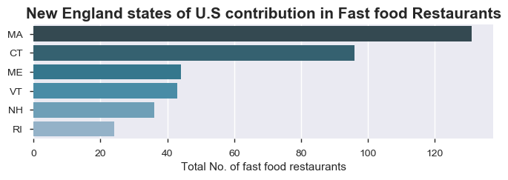
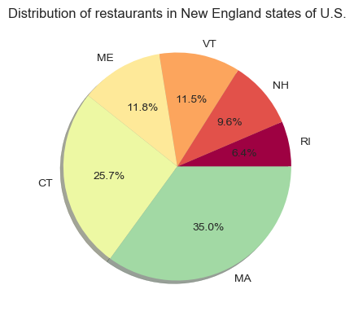
Distribution of fast food restaurants in Northeast U.S
Distribution in New England states of U.S
The MA state contribute 35.0% in fast food restaurants which is highest in New England state of U.S.
The MA state have 131 fast food restaurants which is highest in New England states of U.S.
New England state of U.S have 374 fast food restaurants which is 3.74% of total restaurants resides in U.S.

Slide 16
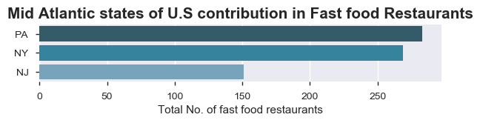
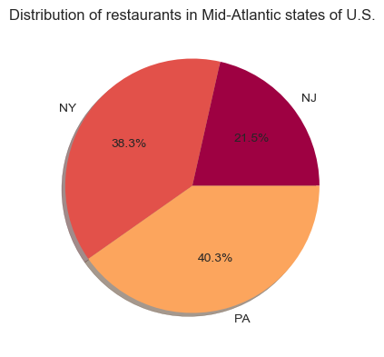
Distribution of fast food restaurants in Northeast U.S
Distribution in Mid Atlantic states of U.S
The PA state contribute 40.3% in fast food restaurants which is highest in Mid Atlantic state of U.S.
The PA state have 283 fast food restaurants which is highest in Mid Atlantic states of U.S.
Mid Atlantic state of U.S have 703 fast food restaurants which is 7.03% of total restaurants resides in U.S.

Slide 17
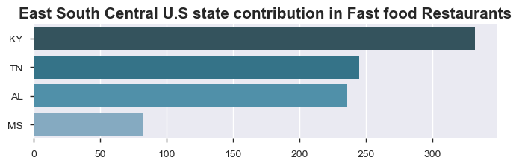
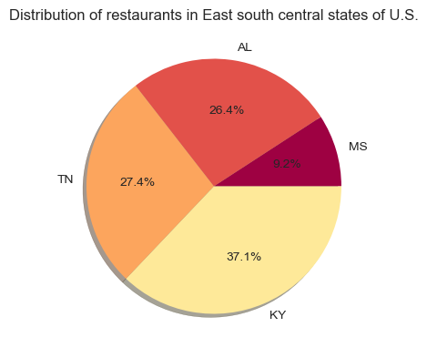
Distribution of fast food restaurants in Southern U.S
Distribution in east south Central states
The KY state have 332 fast food restaurants which is highest in east south central states of U.S.
east south central state have total 895 fast food restaurants which is 8.95% of total restaurants in U.S.
The KY state contribute 37.1% in fast food restaurants which is highest in east south central states of U.S.

Slide 18
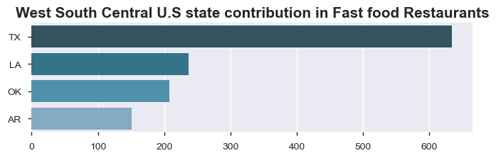
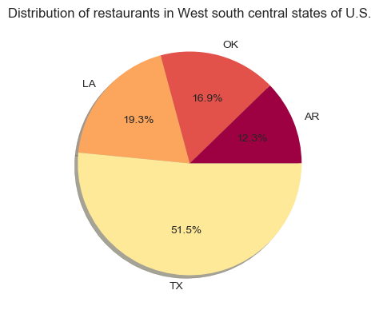
Distribution of fast food restaurants in Southern U.S
Distribution in west south Central states
The TX state have 634 fast food restaurants which is highest in west south central states of U.S.
west south central state have total 1230 fast food restaurants which is 12.30% of total restaurants in U.S.
The TX state contribute 51.5% in fast food restaurants which is highest in west south central state of U.S.

Slide 19
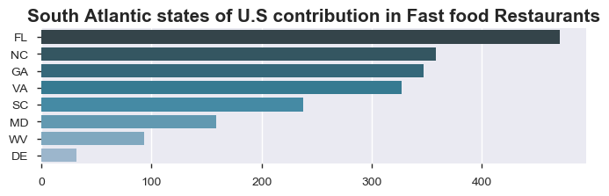
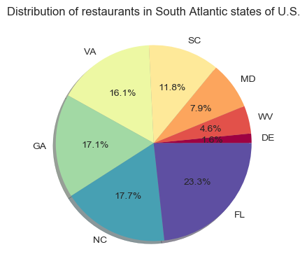
Distribution of fast food restaurants in Southern U.S
Distribution in South Atlantic states of U.S
The FL state have 471 fast food restaurants which is highest in south Atlantic states of U.S.
south Atlantic states have total 2025 fast food restaurants which is 20.25% of total restaurants resides in U.S.
The FL state contribute 23.3% in fast food restaurants which is highest in South Atlantic state of U.S.

Slide 20
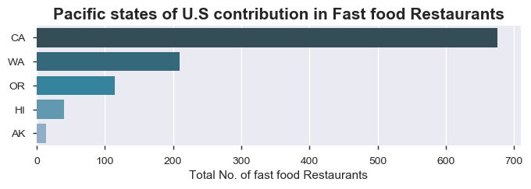
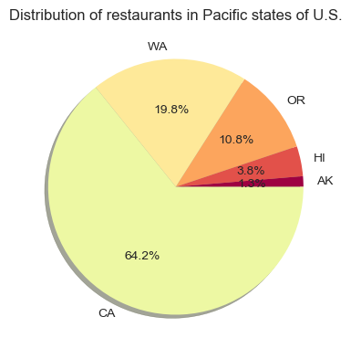
Distribution of fast food restaurants in Western U.S
Distribution in Pacific states of U.S
The CA state have 676 fast food restaurants which is highest in Pacific states of U.S.
Pacific states have total 1053 fast food restaurants which is 10.53% of total restaurants resides in U.S.
The CA state contribute 64.2% in fast food restaurants which is highest in Pacific state of U.S.

Slide 21
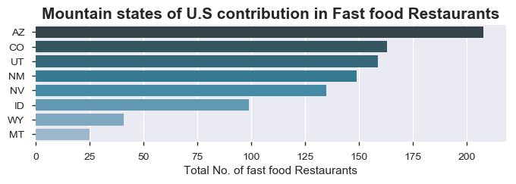
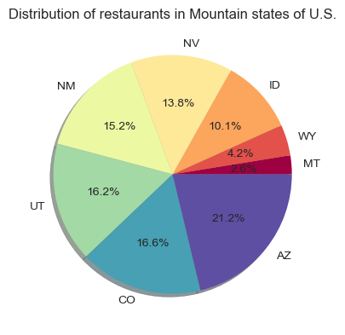
Distribution of fast food restaurants in Western U.S
Distribution in Mountain states of U.S
The AZ state have 208 fast food restaurants which is highest in Mountain states of U.S.
Mountain states have total 979 fast food restaurants which is 9.79% of total restaurants resides in U.S.
The AZ state contribute 21.2% in fast food restaurants which is highest in Mountain state of U.S.

Slide 22
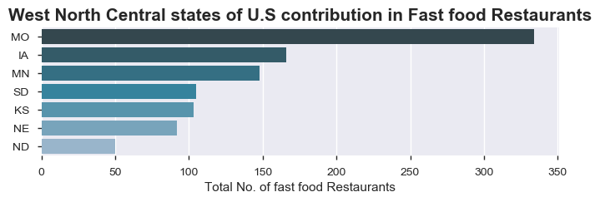
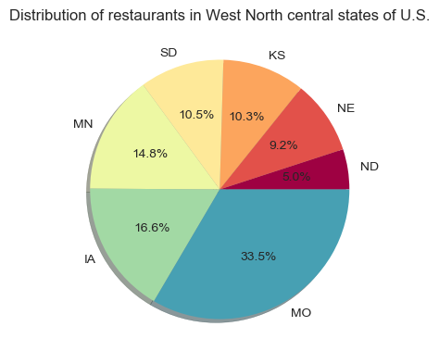
Distribution of fast food restaurants in MidWest region of U.S
Distribution in West North central states of U.S
The MO state have 334 fast food restaurants which is highest in West North central states of U.S.
West North central states have total 998 fast food restaurants which is 9.98% of total restaurants resides in U.S.
The MO state contribute 33.5% in fast food restaurants which is highest in West North central state of U.S.

Slide 23

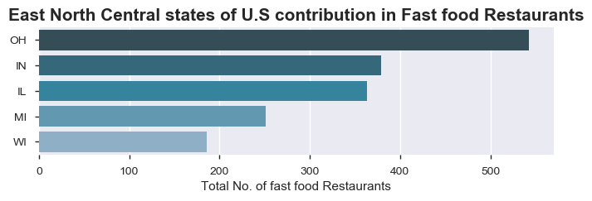
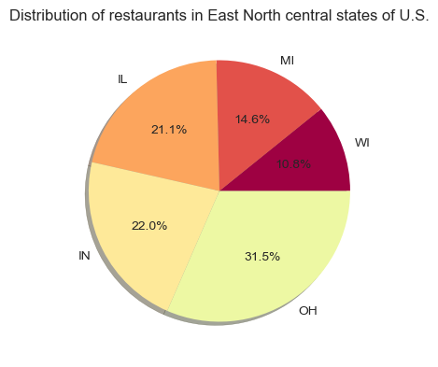
Distribution of fast food restaurants in MidWest region of U.S
Distribution in West North central states of U.S
The OH state have 543 fast food restaurants which is highest in East North central states of U.S.
east North central states have total 1722 fast food restaurants which is 17.22% of total restaurants resides in U.S
The OH state contribute 31.5% in fast food restaurants which is highest in East North central state of U.S.

Slide 24
Conclusion
As the CA state lies in western region of U.S is a most populous state and third largest by area in U.S has a maximum no. of fast food restaurants which is 676 reported in the given dataset is absolutely correct.
CA and TX state both are most populous state in western and southern region contribute 6.8% and 6.3% in fast food restaurants.
Cincinnati city lies in Ohio state lies in Midwest region which is 3rd populous city in the state have 119 fast food restaurants in the given dataset is absolutely correct.
mcdonalds is the most famous fast food restaurants in U.S because of it's quick service restaurants and the variety of food available , in the given dataset there are total 2105 mcdonald's restaurants in United states which is 21.05% with respective to total no. of restaurants resides in United states.
TX state lies in West south central division of southern region have 166 mcdonald's restaurants which is higher than other states in United States,also we can see that in the plotly plot that mcdonald's restaurants presence is maximum in Midwest ,South and NorthEast region as compared to Western region.
FL state lies in south Atlantic division of southern region have 92 burger king restaurants which is higher than other states in United states , also we can see that in the plotly plot that burger king restaurants presence is maximum in Midwest ,South and NorthEast region as compared to Western region.

Slide 25
Conclusion
CA,TX and OH are the top 3 states in U.S which have maximum no. of fast food restaurants, there are few outlier points lies in the given dataset (like few fast food restaurants lies outside of U.S country but mentioned that these points (latitude and longitude) points lies in U.S which is wrong.) we have pointed out in the 4.4 section
AK state lies in western region have diverse terrain of open spaces, mountains and forests, with abundant wildlife and many small towns and also lowest population strength causes minimum no. of fast food restaurants which is 14 in the reported in the given dataset.
Long Branch,Mena,Medicine Lodge,Media,Mechaniville,Mcloud,Mckeesport,Mc Farland,Mc Cordsville,Mc Calla these first 10 cities have only 1 fast food restaurants resides in U.S.
Northeast states of U.S have total 1077 fast food restaurants which is again divided separately into 2 division. New England division have 6 states having 374 restaurants with Massachusetts (MA) state have highest no. of fast food restaurants which is 131. Mid Atlantic division have 3 states having 703 restaurants with Pennsylvania (PA) state have highest no. of fast food restaurants which is 283.Also have few outlier points (restaurants) which is not lies in northeast region of United States.

Slide 26
Conclusion
Southern region of U.S have total 4150 fast food restaurants which is again divided separately into 3 division. east south central division have 4 states having 895 restaurants with Kentucky (KY) state have highest no. of fast food restaurants which is 332. west south central division have 4 states having 1230 restaurants with Texas (TX) state have highest no. of fast food restaurants which is 634. south Atlantic division have 8 states having 2025 restaurants with Florida state have highest no. of fast restaurants which is 471.Also have few outlier points (restaurants) which is not lies in Southern region of United States.
Western region of U.S have total 2032 fast food restaurants which is again divided separately into 2 division. Pacific division have 5 states having 1053 restaurants with California (CA) state have highest no. of fast food restaurants which is 1053. Mountain division have 8 states having 979restaurants with Arizona (AZ) state have highest no. of fast food restaurants which is 979.Also have few outlier points (restaurants) which is not lies in Western region of United States.

Slide 27
Conclusion
Midwest region of U.S have total 2720 fats food restaurants which is again divided separately into 2 division. west north central division have 7states having 998 restaurants with Missouri (MO) state have highest no. of fast food restaurants which is 334. east north central division have 5 states having 1722 restaurants with Ohio(OH) state have highest no. of fast food restaurants which is 543.Also have few outlier points (restaurants) which is not lies in Mid-west region of United States.
So people in U.S like food from the mcdonald's due to it's popularity ,brand as it’s oldest in U.S quality of food they provide and other factors.
As the population of Southern region in U.S is higher than the remaining 3 region so there are 4150 i.e (41.50%) fast food restaurants in U.S which is absolutely correct.
finally we can conclude that fast food restaurants in U.S depends upon the population density and other factors like location also.

Slide 28


